Slide 1
Fundamental of Microprocessor
UNIT - 1

Slide 2
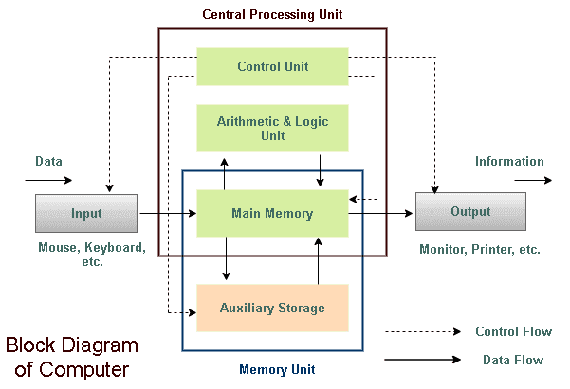
Block Diagram of Computer

Slide 3
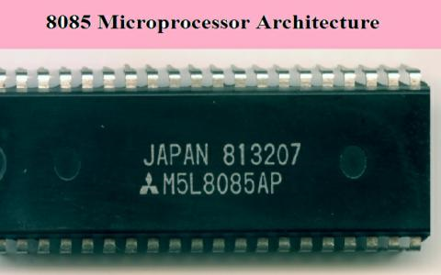

Slide 4
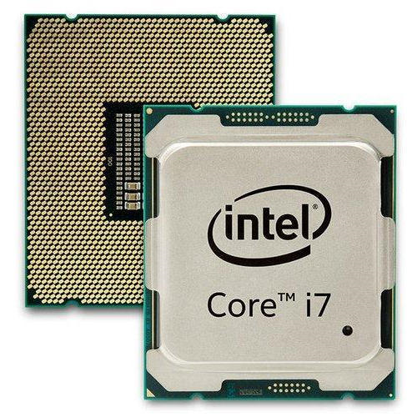

Slide 5
Definition
Microprocessor is
Multipurpose
Programmable
Clock driven
Register based
Electronic device
Reads binary instructions from storage device called memory
Accepts data as binary input
Processes data according to instructions
Provides results as output

Slide 6
Microprocessor is multipurpose, programmable, Clock driven, Register based Electronic device that reads binary instructions from storage device called memory and accepts data as binary input, processes data according to instructions provides results as output.

Slide 7
Microprocessor operates in binary 0 or 1
Each processor recognizes and processes a group of bits called word
Microprocessor are classified according to their word length such as 8 bits, 16 bits etc

Slide 8
Applications
Microcontrollers
Measurement and testing equipment
Blood group analyzers
X-ray analyzer
Signal generators
Washing machine
Microwave oven
Scientific and engineering research
Industry
Security system: smart cameras, CCTV, smart door
Traffic light control

Slide 9
Advantage of microprocessor
Computational speed is high
Intelligence has been brought to system
Automation of industrial process and office automation
Flexible
Compact in size
Maintenance is easier

Slide 10
System Bus
A bus is a subsystem that is used to connect computer component and transfer data between them.
A system bus is single computer bus that connects the major components of a computer system combining the functions of a Data bus to carry information, an Address bus to determine where it should be sent and Control bus to determine its operation.

Slide 11
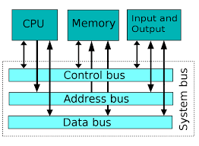

Slide 12
Design of the system bus varies from system to system and can be specific to particular computer design.
System bus characteristics are dependent on need of the processor, the speed, and the wordlength of data and instructions.
Size of bus :- known as width, determines how much data can be transferred at a time and indicates the number of available wires.
32 bit bus refers 32 parallel wires that can simultaneously transfer 32 bits.

Slide 13
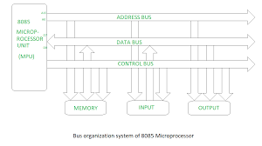
Microprocessor with bus organization

Slide 14
Microprocessor with Bus organization
Bus is a group of conducting wires which carries information.
All peripherals are connected to microprocessor through bus.
Three types of buses
Address bus
Control Bus
Data Bus

Slide 15
Address Bus
It is group of conducting wires which carries address only.
Address bus is unidirectional because data flow in one direction, from microprocessor to memory or from microprocessor to input /output devices.
Length of address bus of 8085 is 16 bit or 4 hexa digits, from 0000 H to FFFF H.
It can address 65536 different memory locations

Slide 16
Data Bus
Group of conducting wires which carries data only.
Data bus is bidirectional because data flow both way from microprocessor to memory or I/O devices and from memory or Input/output devices to microprocessor.
8085 have 8 bit data bus means 2 hexadecimal ranging from 00 H to FF H.
Write operation: processor will put data to be written in the data bus.
Read operation: memory controller will put data into data bus from specific memory location.

Slide 17
Width of data bus is directly related to largest number that the bus can carry, such as 8 bit can carry from 0 to 255.

Slide 18
Control bus
It is group of conducting wires which is used to generate timing and control signals to all associated peripherals.
Some control signals are:
Memory Read
Memory write
I/O read
I/O write
Opcode fetch

Slide 19
Microprocessor Architecture and operations
Microprocessor is programmable digital device, designed with registers, flip-flops and timing elements.
The microprocessor has set of instructions designed internally to manipulate data and communicate with peripherals.
The process of data manipulation and communication is determined by the logic design of the microprocessor, called architecture.

Slide 20
Microprocessor can be programmed to perform functions on given data by selecting necessary instructions from its set.
This instructions are given to the microprocessor by writing them into memory.
Writing or entering instructions and data are given by input device.

Slide 21
The microprocessor reads or transfer one instructions at time, matches it with its instructions set and performs data manipulation indicated by instructions.
The result can be store into the memory or send to output device.

Slide 22
Microprocessor can respond to external signals.
It can be interrupted ,reset, or asked to wait to synchronize with slower peripherals.

Slide 23
8085
8085 is complete 8 bit parallel CPU.
Main components are:-
Array of registers
ALU
Encoder/Decoder
Timing and control circuits
All components are linked by internal data bus.

Slide 24
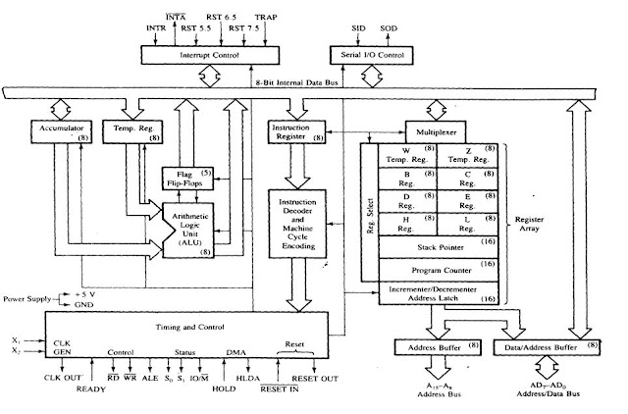
8085 microprocessor functional block diagram

Slide 25
ALU
Performs computing functions
Includes accumulator, temporary registers, arithmetic and logic circuits and five flags.
Temporary registers hold data during Arithmetic and logic operations.
Result is stored in accumulator.
Flag (flip-flops) are set or reset according to the result of operations.

Slide 26
Accumulator(register A):
8 bit register which is part of ALU
stores 8 bit data
8085 is accumulator based microprocessor
When data is read from input port it is moved to accumulator and when data is send to output port, it must be first place in accumulator.

Slide 27
Temporary Register(W and Z)
8 bit registers not accessible to the programmer
During program execution 8085 places the data for short period
Instruction Register(IR)
8 bit register not accessible to the programmer
It receive the operation code from internal data bus and passes to the instruction decoder which decodes so that microprocessor knows which type of operation to perform.

Slide 28
Registers Array
General Purpose Registers • B, C, D, E, H & L (8 bit registers) • Can be used singly • Or can be used as 16 bit register pairs –BC, DE, HL • H & L can be used as a data pointer (holds memory address)
Data can be directly added or transferred from one to another.
Contain can be incremented or decremented or combined logically with the contain of the accumulator

Slide 29
Stack Pointer
It is 16 bit register known as memory pointer
It points to the memory location in RAM called stack
The beginning of the stack is defined by loading a 16 bit address in the stack pointer.
Program Counter
This is a register that is used to control the sequencing of the execution of instructions.
This register always holds the address of the next instruction.
PC is incremented by 1to point next memory location.

Slide 30
Flag register
Registers consists of five flip-flops, each holding the status of different states separately.
Known as flag registers or flags
8085 set or reset one or more flags.
S (sign flag), Z (zero flag), AC (auxillary carry flag), P (parity flag) & CY (carry flag)

Slide 31
Carry(CY)- If the last operation generates a carry, its status will be 1 otherwise 0
It can handle the carry or borrow from one word to another
Zero(Z)-If the result of last operation is zero, Its status will be 1 otherwise 0
It is often used in loop control and in searching for particular data value
Sign(S)-If the MSB of the result of the last operation is 1(negative) then its status will be 1 otherwise 0
Parity (P)-If the result of last operation has even number of 1’s its status will be 1 otherwise 0
Auxillary Carry(AC)- If the last operation generates carry from the lower half word its status will be 1otherwise 0. Used for performing BCD arithmetic.

Slide 32
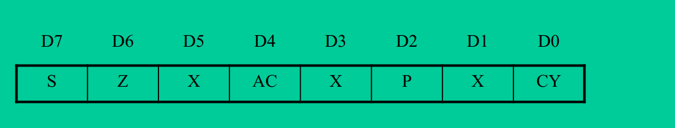

Slide 33
Timing and control unit
This unit synchronizes all the microprocessor operations with the clock and generates necessary control signals for communications between microprocessor and peripherals.
Interrupt controls
The various interrupt control signals are used to interrupt microprocessor.
INTR, RST 5.5, RST 6.5, RST 7.5 and TRAP
Serial I/O control
Two serial I/O control SID and SOD are used for serial data transmission.

Slide 34
Microprocessor operations
Functions performed by microprocessor can be classified in three general category.
Microprocessor initiated operations
Internal operations
Peripheral(or externally initiated) operations

Slide 35
Microprocessor initiated operations
Microprocessor performs primarily four operations:
Memory Read:-Read data or instructions from memory
Memory Write:-Write data or instructions from memory
I/O read :-Accepts data from input devices
I/O write:-sends data to output devices
To communicate with a peripherals or a memory microprocessor needs to perform following steps:-
Step1 identify the peripherals or memory location with its address
Step2 transfer binary information(data or instructions)
Step 3 provide timing or synchronization signals

Slide 36
8085 perform this using set of communications lines called buses.
Address bus, data bus and control bus.

Slide 37
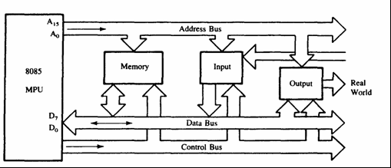
8085 Bus structure

Slide 38
Address Bus
8085 Microprocessor has 16 bit address bus.
The bus over which the CPU sends out the address of the memory location is known as Address bus.
The address bus carries the address of memory location or peripherals devices to be written or to be read from.
The address bus is unidirectional. It means bits flowing occurs only in one direction, only from microprocessor to peripheral devices.
NOTE:-We can find that how much memory location is needed ,by using the formula 2^N. where N is the number of bits used for address lines.

Slide 39
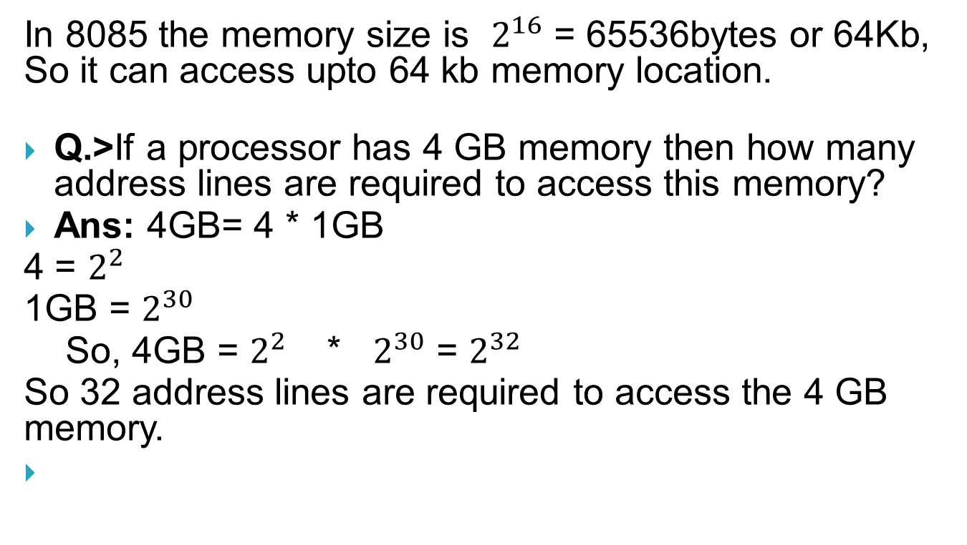
In 8085 the memory size is $2^{16}$ = 65536bytes or 64Kb, So it can access upto 64 kb memory location.
Q.>If a processor has 4 GB memory then how many address lines are required to access this memory?
Ans: 4GB= 4 * 1GB
4 = $2^{2}$
1GB = $2^{30}$
So, 4GB = $2^{2}$ * $2^{30}$ = $2^{32}$
So 32 address lines are required to access the 4 GB memory.

Slide 40
Data bus
8085 Microprocessor has 8 bit data bus.
So it can be used to carry the 8 bit data starting from 00000000H(00H) to 11111111H(FFH). Here 'H' tells the Hexadecimal Number.
It is bidirectional. These lines are used for data flowing in both direction means data can be transferred or can be received through these lines.
The data bus also connects the I/O ports and processor.
The largest number that can appear on the data bus is 11111111.
It has 8 parallel lines of data bus. So it can access upto 2^8 = 256 data

Slide 41
Control Bus
Control bus is comprised of various single lines that carry synchronization signals.
These are not group of lines as in data bus and address bus, it is a individual line that provides a pulse to indicate microprocessor operations.
The microprocessor generates specific control signals for every operations.

Slide 42
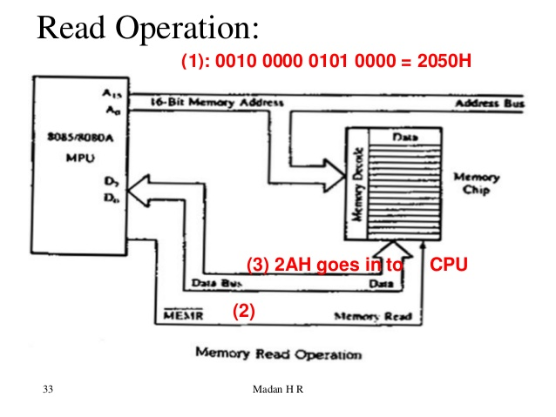
Memory read operation

Slide 43
Internal Data operations
Internal architecture of microprocessor define what and how the operations can be performed with the data. These operations are:
Store 8 bit data
Perform arithmetic and logical operations
Test for conditions
Sequence the execution of instructions
Store data temporarily during execution in the defined R/W memory locations called stack

Slide 44
To perform all operations the microprocessor requires registers , ALU and control unit, and internal buses.

Slide 45
Peripherals or Externally initiated operations
External devices can initiate the following operations, for which individual pins on the microprocessor chip are assigned: Reset, Interrupt, Ready, Hold.
Reset:
When reset pin is activated by an external key, all internal operations are suspended and the program counter is cleared to 0000H. Now the program execution can again begin at the zero memory address.
Interrupt:
The microprocessor can be interrupted from the normal execution of instructions and asked to execute some other instructions called service routine. The microprocessor resumes its operation after completing the service routine.

Slide 46
Ready:
8085 has pin called ready. When this ready pin is low, the microprocessor enters into Wait state. This signal is used primarily to synchronize slower peripherals with microprocessor.
Hold:
When the HOLD pin is activated by an external signals, the microprocessor relinquishes control of buses and allows the external peripheral to use them.

Slide 47
8085 Pin configuration
8085 is 8 bit microprocessor.
It has 16 bit address bus with 64 KB addressing capabilities.
8085 is 40 pin DIP package.
The pins can be grouped as
1. power supply and clock signals
2. Address bus
3. Data Bus
4. Control and status bus
5. Interrupt and externally initiated signals
6. Serial I/O port

Slide 48
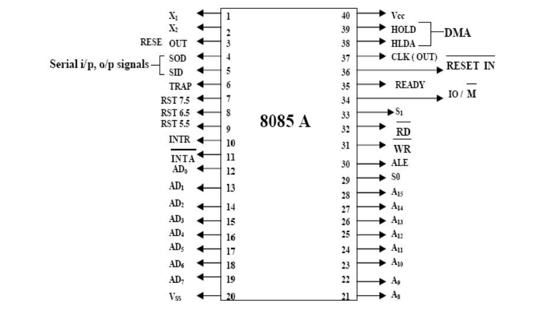
8085 Pin configuration

Slide 49
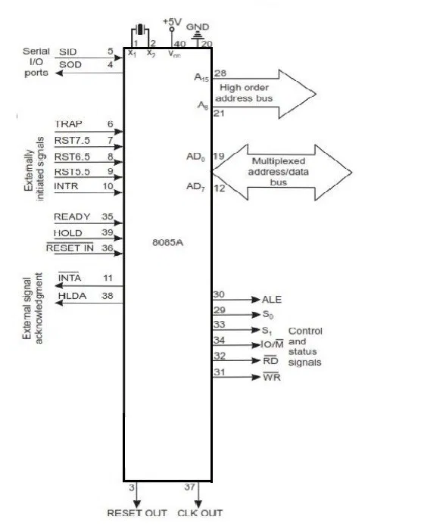

Slide 50
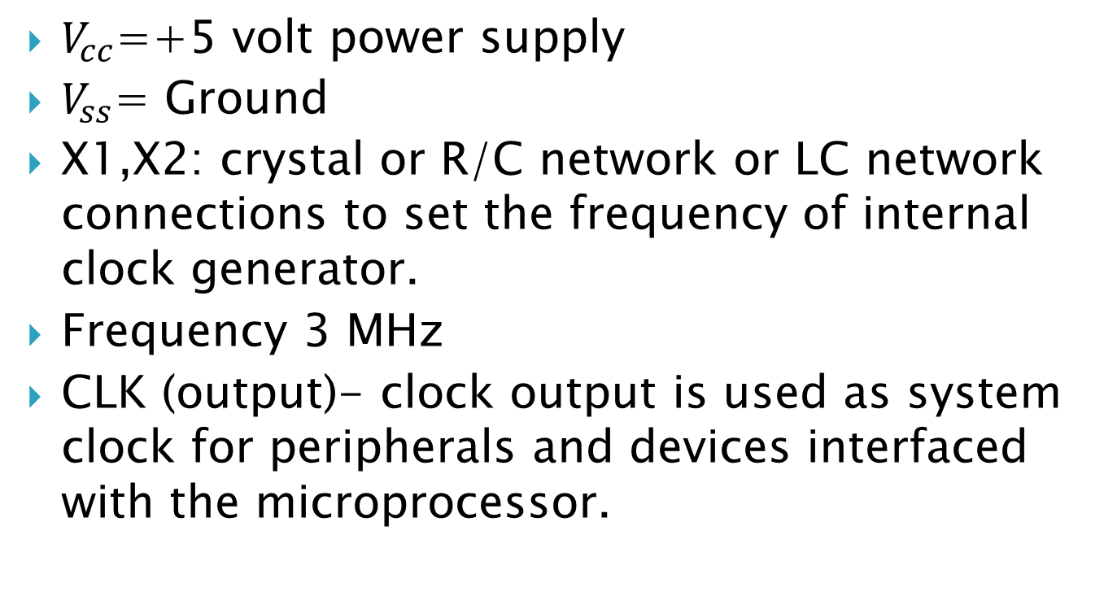
1. Power supply and clock frequency
$V_{cc}$=+5 volt power supply
$V_{ss}$= Ground
X1,X2: crystal or R/C network or LC network connections to set the frequency of internal clock generator.
Frequency 3 MHz
CLK (output)- clock output is used as system clock for peripherals and devices interfaced with the microprocessor.

Slide 51
2. Address Bus
A8-A15
It carries most significant bits of memory address or the 8 bits of the I/O address.

Slide 52
3. Multiplexed Address /Data Bus
AD0-AD7
These multiplexed set of lines used to carry the lower order 8 bit address as well as data.
During the opcode fetch operation, in the first clock cycle, the lines deliver the lower order address A0-A7.
In subsequent IO/Memory, Read/Write clock cycle the lines are used as data bus.
The CPU may read or write out data through this lines.

Slide 53
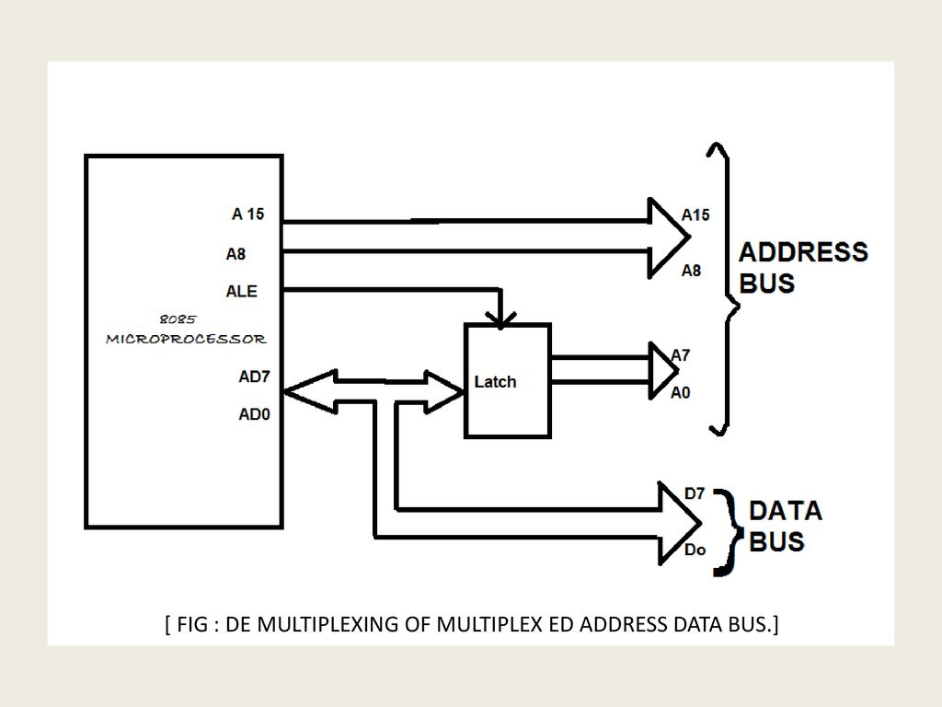

Slide 54
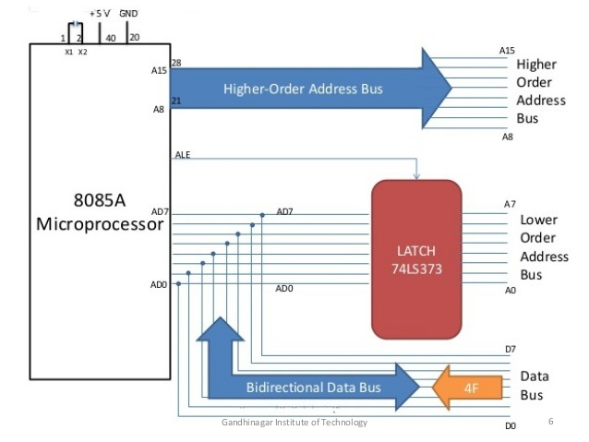

Slide 55
4. Control and status signal
These signals contains two control signal (RD and WR) , three status signal(IO/M,S1 and S0) to identify the nature of operations and one special signal (ALE) to indicate the beginning of operations.
ALE (Output):- Address Latch Enable
The signal helps to capture the lower order address presented on the multiplexed address/ data bus.
RD(Active Low):-Read memory or IO device
It means that the selected memory location or I/O device is to be read and that the data bus is ready to accept data from memory or I/O device.

Slide 56
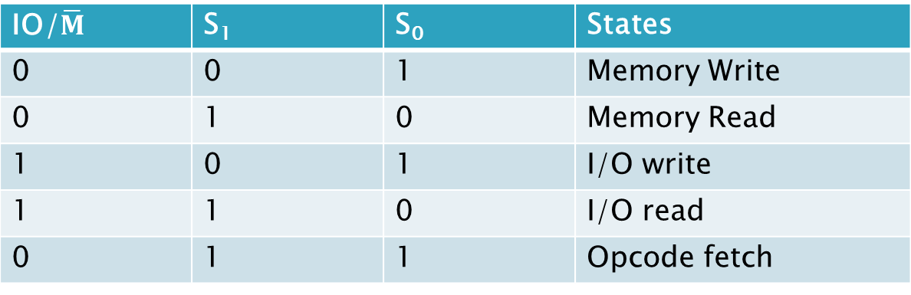
WR (Active Low):- Write memory or I/O device
This indicates that the data on the data bus is to be written into the selected memory location or I/O device.
IO/M(output):- Select memory or I/O device
The status signal indicates that the read/ write operation relates to whether the memory or I/O device. It goes high to indicate an I/O operation and low for ,memory operation.
IO/$\overline{M}$ | S₁ | S₀ | States
0 | 0 | 1 | Memory Write
0 | 1 | 0 | Memory Read
1 | 0 | 1 | I/O write
1 | 1 | 0 | I/O read
0 | 1 | 1 | Opcode fetch

Slide 57
5. Interrupt and externally initiated signals
Interrupt are the signals generated by external devices to request the microprocessor to perform a task. There are 5 interrupt TRAP, RST 7.5,RST6.5,RST5.5 and INTR.
INTA:-It is interrupt acknowledgement signal.
RESET IN:-When the signal on this pin is low, the PC is set to 0, and microprocessor is reset.
RESET OUT:- This signal indicates that the processor is being reset. The signal can be used to reset other connected devices.

Slide 58
READY:- This means device is ready to send and receive data. When this signal is low, the processor waits for an integral number of clock cycles until it goes high.
HOLD:-this signal indicates that other master is requesting the use of address and data buses.
HLDA(HOLD Acknowledge):-It indicates that CPU has received HOLD request and it will relinquish the bus in next clock cycle. HLDA is set to low after HOLD signal is removed.

Slide 59
6. Serial I/O signals
SOD and SID:- These lines are used for serial communication.
SOD(Serial output data line):- The output SOD is set/reset as specified by SIM (Set Interrupt Mask) Instructions.
SID(Serial input data line):- The data on this line is loaded into accumulator whenever a RIM (Read Interrupt Mask) instruction is executed.

Slide 60
Interrupts in 8085
Interrupts are the signals generated by the external devices to request the microprocessor to perform a task. There are five types of interrupt i.e RST5.5,RST6.5,RST7.5, INTR and TRAP. Interrupt are classified into following groups on basis on their parameter:
Vector Interrupt:-
In this type of interrupt, the interrupt address is known to the processor. For example RST7.5, RST6.5,RST5.5 ,TRAP.

Slide 61
Non vector Interrupt
In this type of interrupt the interrupt address is not known to processor. So, address need to be send externally by the device to perform interrupts.
Example: INTR
Maskable interrupt
In this type of interrupt, interrupt can be disable by writing some instructions in a program. For example RST5.5,RST6.5,RST7.5
Non maskable Interrupt
In this type of interrupt we cant disable the interrupt by writing some instructions in the program. For Example TRAP

Slide 62
Software interrupt
In this type of interrupt the programmer had to add the instructions into the program to execute the interrupt . There are 8 software interrupt in 8085, i.e RST 0-7
Hardware interrupt
There are 5 hardware interrupt in 8085 used as hardware interrupt i.e Trap,RST5.5,RST6.5,RST7.5,INTA

Slide 63
Interrupt Service Routine(ISR)
A small program or a routine that when executed, services the corresponding interrupting source is called ISR.
TRAP
Non maskable interrupt
Has highest priority among all interrupt
By default it is enabled until it get acknowledged
This transfers control to 0024H

Slide 64
RST 7.5
Maskable interrupt
Have second priority
When interrupt is executed, the processor saves the content of the PC register into the stack and branches to 003CH
RST 6.5
Maskable interrupt
Have third priority
When interrupt is executed, the processor saves the content of the PC register into the stack and branches to 0034H

Slide 65
RST 5.5
Maskable interrupt
When interrupt is executed, the processor saves the content of the PC register into the stack and branches to 002CH

Slide 66
INTR
Maskable interrupt
Have lowest priority
It can be disable by resetting microprocessor
When INTR goes high following event occurs:
The microprocessor checks the status of INTR signal during the execution of each instruction.
When INTR signal is high then microprocessor completes its current instruction and sends active low interrupt acknowledge signal.
When instructions are received then microprocessor saves the address of the next instruction on stack and executes the received instruction.

Slide 67
Addressing modes of 8085
The different ways in which a processor can access data are referred as its addressing modes.
The addressing mode is indicated in instructions itself.
The various addressing modes are:
Register Addressing Mode
Immediate Addressing Mode
Direct Addressing mode
Register Indirect Addressing Mode
Implied Addressing Mode

Slide 68
Register Addressing Mode
It is most common form of data addressing.
Transfer data from one register to other.
It is carried out with same size registers.
E.g MOV A,B (move data from source register B to Destination Register A)

Slide 69
Immediate Addressing Mode
Data is specified in instructions itself.
Data immediately follows the hexadecimal opcode.
E.g MVI C,3AH ( I implies immediate data and Data 3AH is moved to register C)
Direct Addressing mode
The Address of data is defined in instruction itself.
E.g LDA 2000H(Load Accumulator with content of 2000H memory.)

Slide 70
1
Register Indiect Addressing Mode
In this mode address of operand is specified by register pair.
H pair, B pair or D pair.
E.g MOV C,M (M is memory location specified by H-L pair and address of operand is in H-L pair register)
Implied Addressing Mode
The Addressing mode of certain instructions is implied by the instructions function.
E.g STC (set carry flag)
CMC (complement carry flag)

Slide 71
Instruction cycle
The necessary steps that the CPU carries out to fetch an instruction and necessary data from memory and to execute it constitute an instruction cycle.
Instruction cycle is defined as time required to complete the execution of an instruction.
An instruction cycle constitute of fetch and execute cycle.
The necessary steps which are carried out to fetch an opcode from memory constitute fetch cycle.
The necessary steps which are carried out to get data if any from memory and to perform the specific operation specified in the instruction constitute of execute cycle.

Slide 72
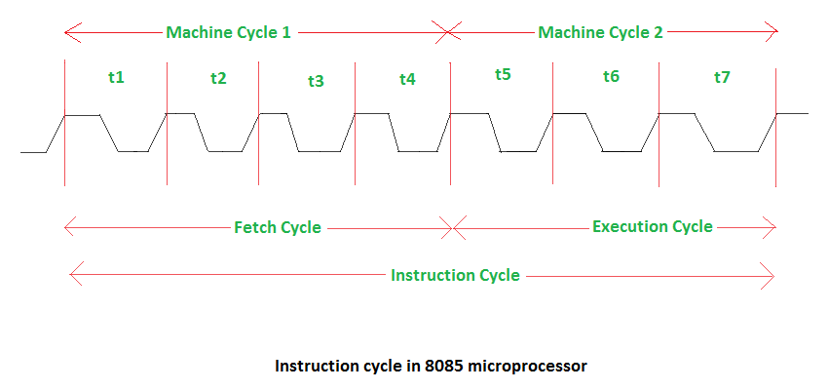
Total time to execute the instruction
IC=Fc+Ec

Slide 73
Fetch cycle
First byte of instruction is its opcode.
The program counter keeps the memory address of the next instruction to be executed in the beginning of fetch cycle.
The content of PC, which is address of instruction to be fetch is send to memory.
The memory places opcode to data bus so as to transfer to CPU.
The entire process takes 2 clock cycle and in next one cycle instruction is decode.

Slide 74
Execution cycle
The opcode fetch from memory goes to IR from IR it goes to decoder which decodes instruction after instruction is decoded execution begins.
If operand is in register, the execution begins immediately and is completed in one clock cycle.
If instruction contains data or operand address then CPU has to perform some read operation to get desired data.
In some instruction write operation is performed. In write cycle data are send from CPU to memory or o/p device.
In some cases execute cycle may involve one or more read or write cycle or both.

Slide 75
Machine Cycle
It is defined as time required to complete one operation of accessing memory, I/O or acknowledging external request.
This cycle may consist of 3 to 6 T states
T States: It is defined as one subdivision of operation in one clock period. These subdivisions are internal states synchronized with system clock and each T states precisely equal to one clock period.

Slide 76
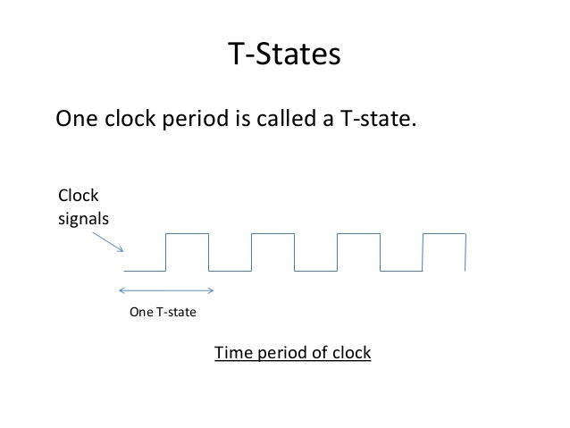

Slide 77
Machine Cycles of 8085
The 8085 has following basic machine cycle
opcode Fetch Cycle(4T)
Memory Read Cycle(3T)
Memory Write Cycle(3T)
I/O read Cycle(3T)
I/O write Cycle(3T)
Interrupt

Slide 78
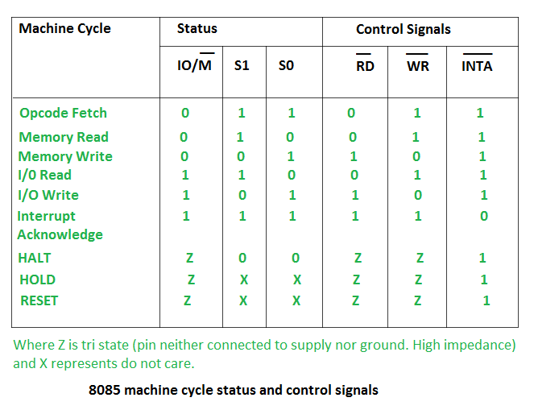

Slide 79
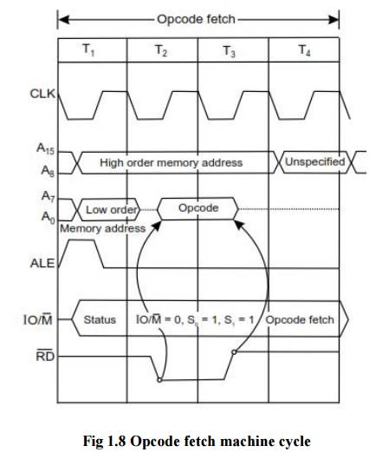
Timing Diagram of opcode fetch machine cycle

Slide 80
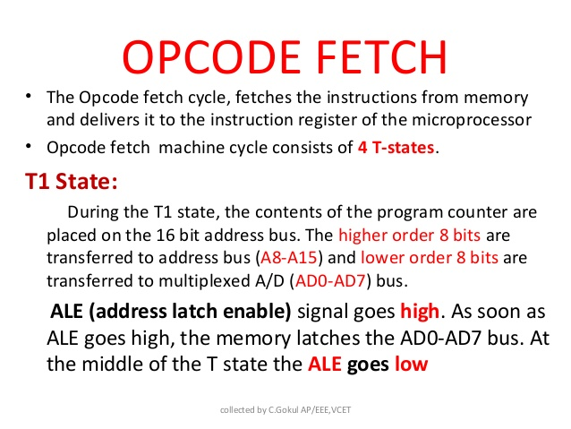

Slide 81
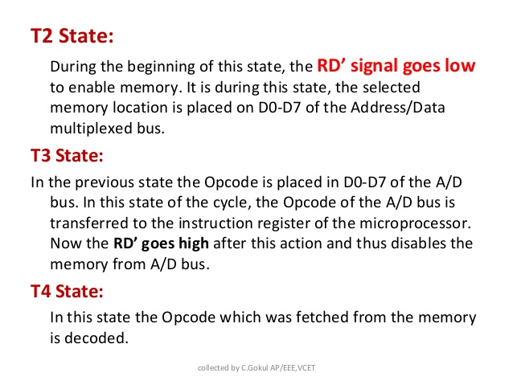

Slide 82
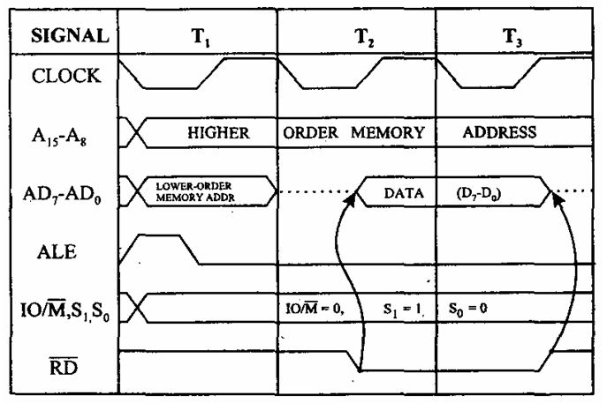
Timing Diagram of memory read cycle

Slide 83
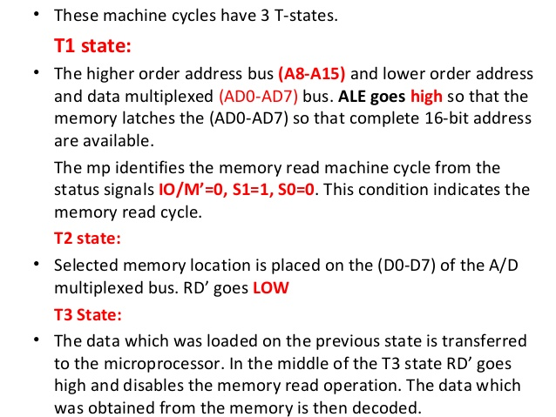

Slide 84
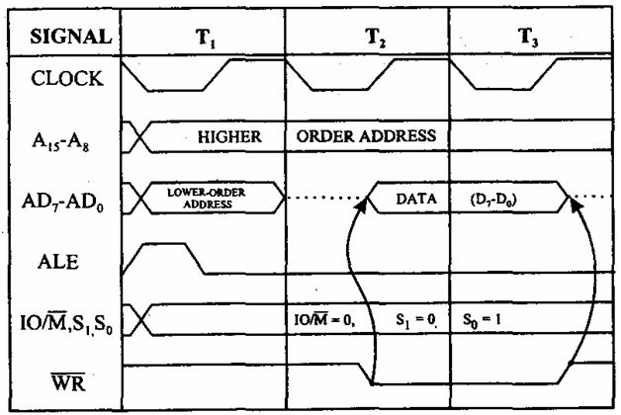
Timing Diagram of memory write cycle

Slide 85
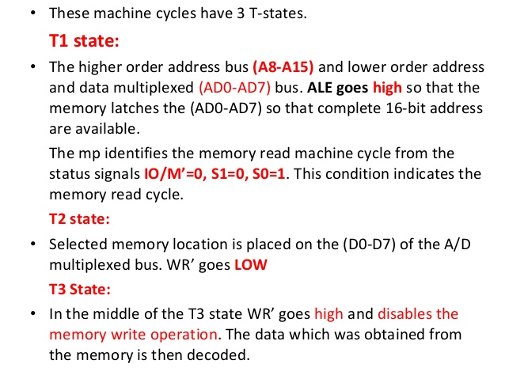

Slide 86
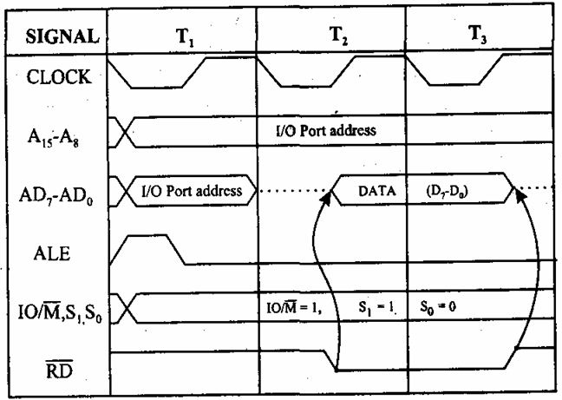
Timing Diagram of I/O read cycle

Slide 87
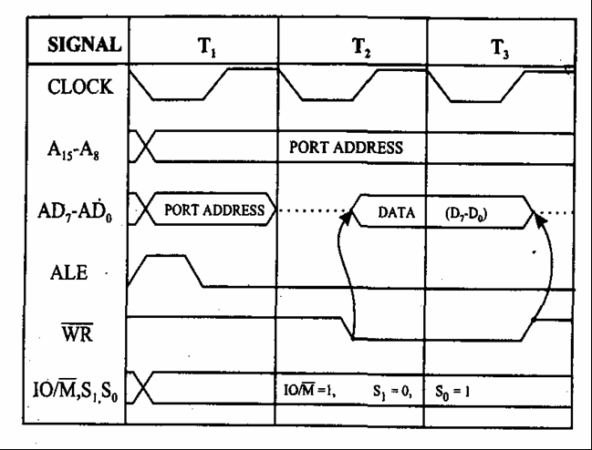
Timing Diagram of I/O write cycle

Slide 88
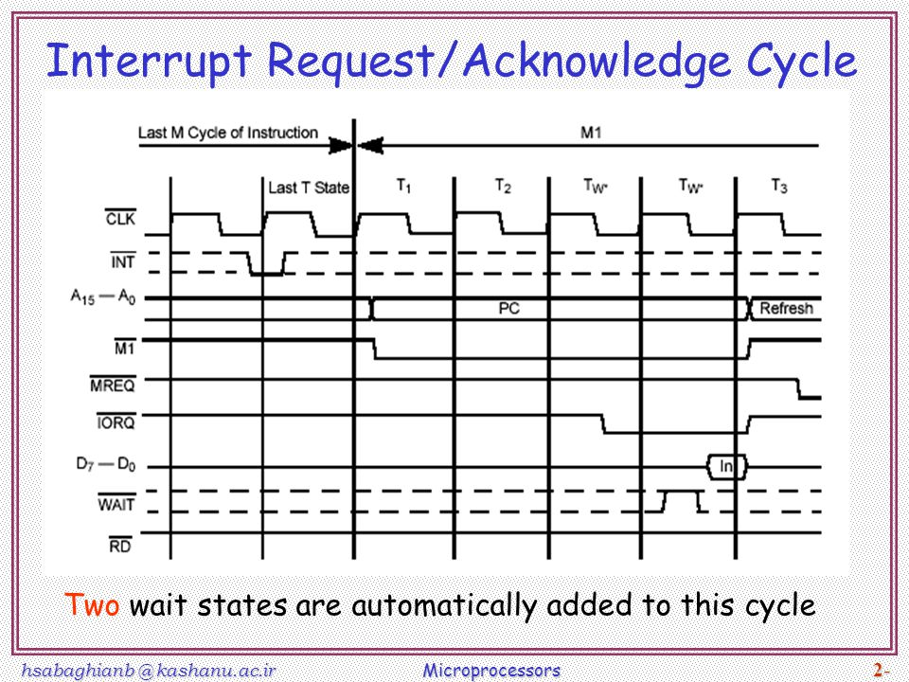

Slide 89
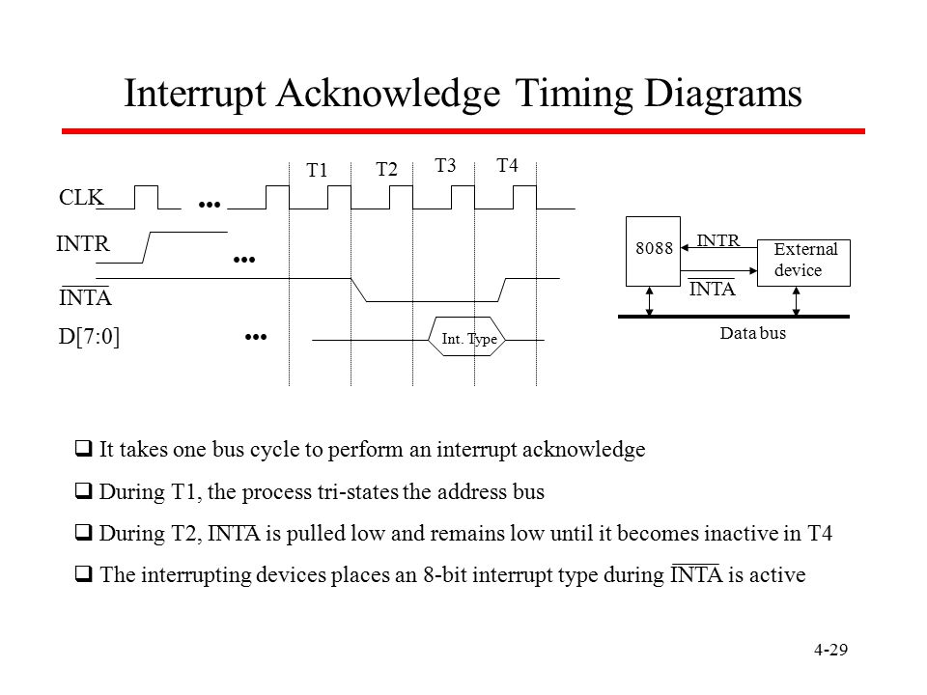

Slide 90
Timing Diagram of opcode machine cycle

Slide 91
Timing Diagram of memory read cycle

